Slide 1
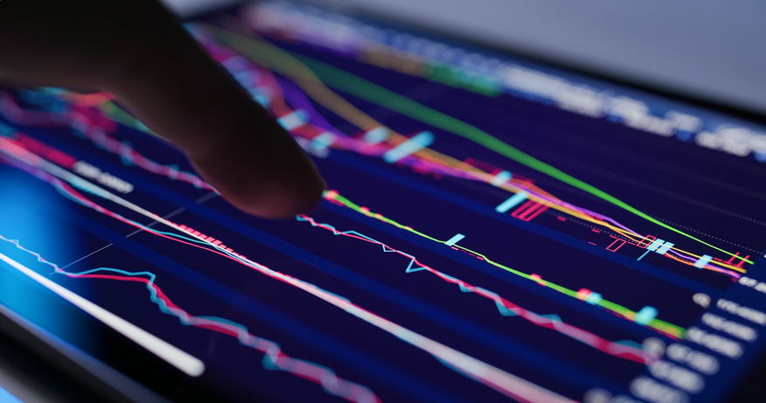
Project 1: Comparative Portfolio Analysis
Charles Panagopoulos, Alex Toenshoff, Ian Melhorn

Slide 2
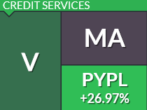

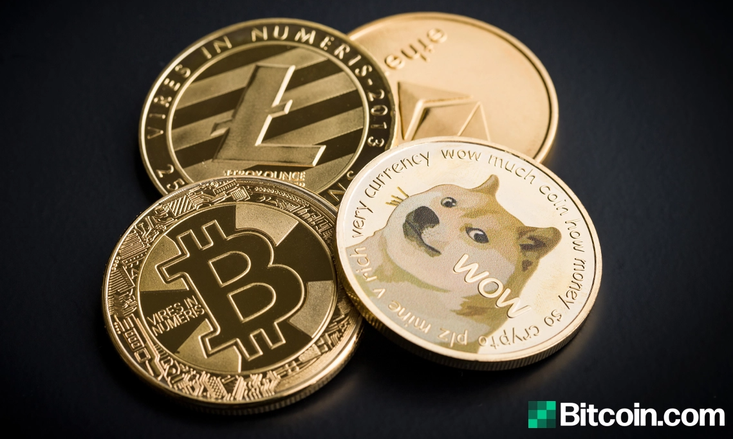
Motivation
5-year historical performance analysis comparing three different portfolios:
Financial portfolio: VISA, SQUARE, PAYPAL, MASTERCARD, AMEX
Technology portfolio: FACEBOOK, AMAZON, APPLE, NETFLIX, GOOGLE
Crypto portfolio: BITCOIN, ETHEREUM, LITECOIN, CARDANO, DOGECOIN
Notes:
Define the core message or hypothesis of your project.
Describe the questions you asked, and why you asked them.
Describe whether you were able to answer these questions to your satisfaction, and briefly summarize your findings.

Slide 3

Questions Summary
Has investing in a basket of cryptos outperformed investing in a basket of FinTech stocks the last 5 years or vice versa?
What is the best portfolio to allocate funds to in terms of risk/reward?
How could investing in a financial stock portfolio vs. a technology stock portfolio impact retirement planning over 10 years?

Slide 4
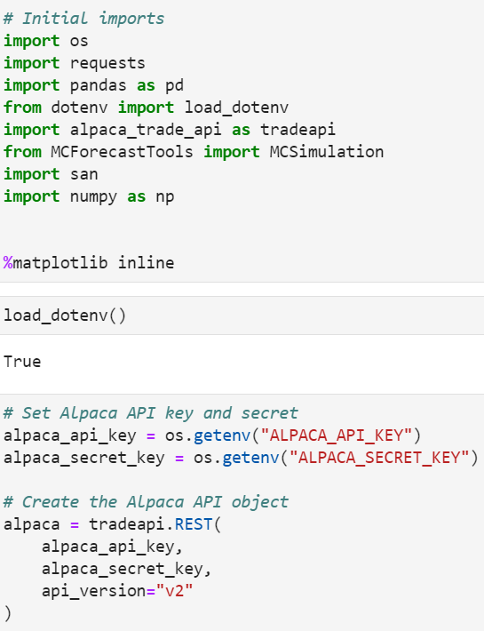
Imports & Libraries
We used the Alpaca API to retrieve the financial portfolio stock data and the technology portfolio stock data.
We used an additional Python library that hasn't been covered in class to retrieve the crypto portfolio data, called Santiment (san).
We used Pandas to clean and format our datasets.
We used NumPy and MCForecastTools for additional visualizations and analysis.
Notes:
Describe the exploration and cleanup process.
Discuss insights you had while exploring the data that you didn't anticipate.
Discuss any problems that arose after exploring the data, and how you resolved them.

Slide 5
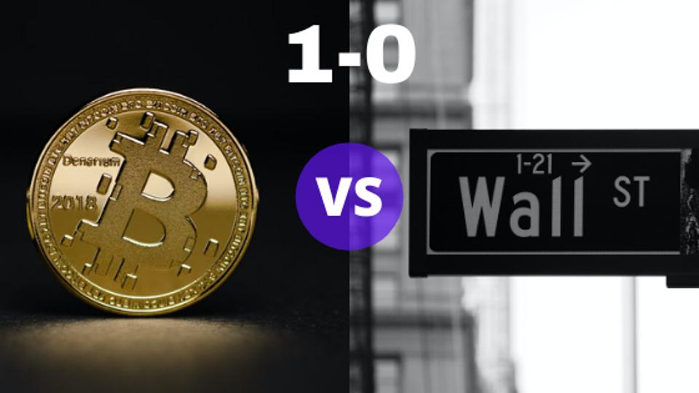
Data Analysis
After calculating the weighted returns for each of the three portfolios, we combined the returns data into one dataframe to perform the quantitative analysis.
We plotted the combined daily returns and cumulative returns across portfolios to assess performance over a 5-year period.
We analyzed portfolio risk, including standard deviations, rolling statistics, correlation, beta (covariance/variance), and sharpe ratios.
Lastly, we’ve conducted monte carlo simulations across portfolios to project performance over a 10-year period.
Notes:
Describe the exploration and cleanup process.
Discuss insights you had while exploring the data that you didn't anticipate.
Discuss any problems that arose after exploring the data, and how you resolved them.

Slide 6
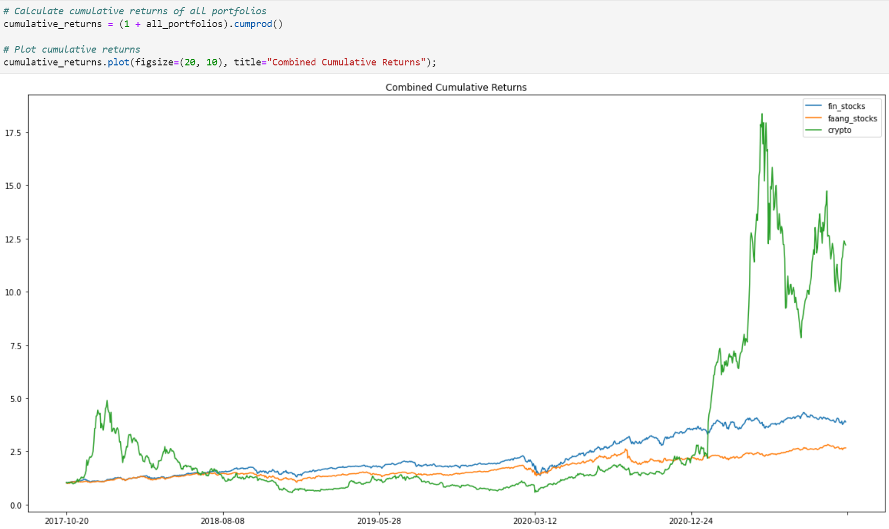
Questions & Data Exploration
Has investing in a basket of cryptos outperformed investing in a basket of FinTech stocks the last 5 years or vice versa?

Slide 7
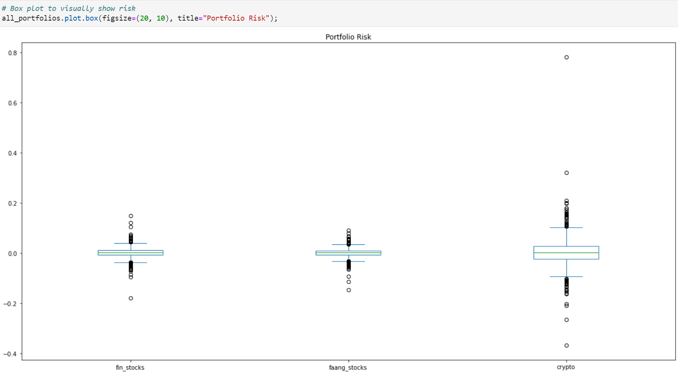
Questions & Data Exploration
What is the best portfolio to allocate
funds to in terms of risk/reward?

Slide 8
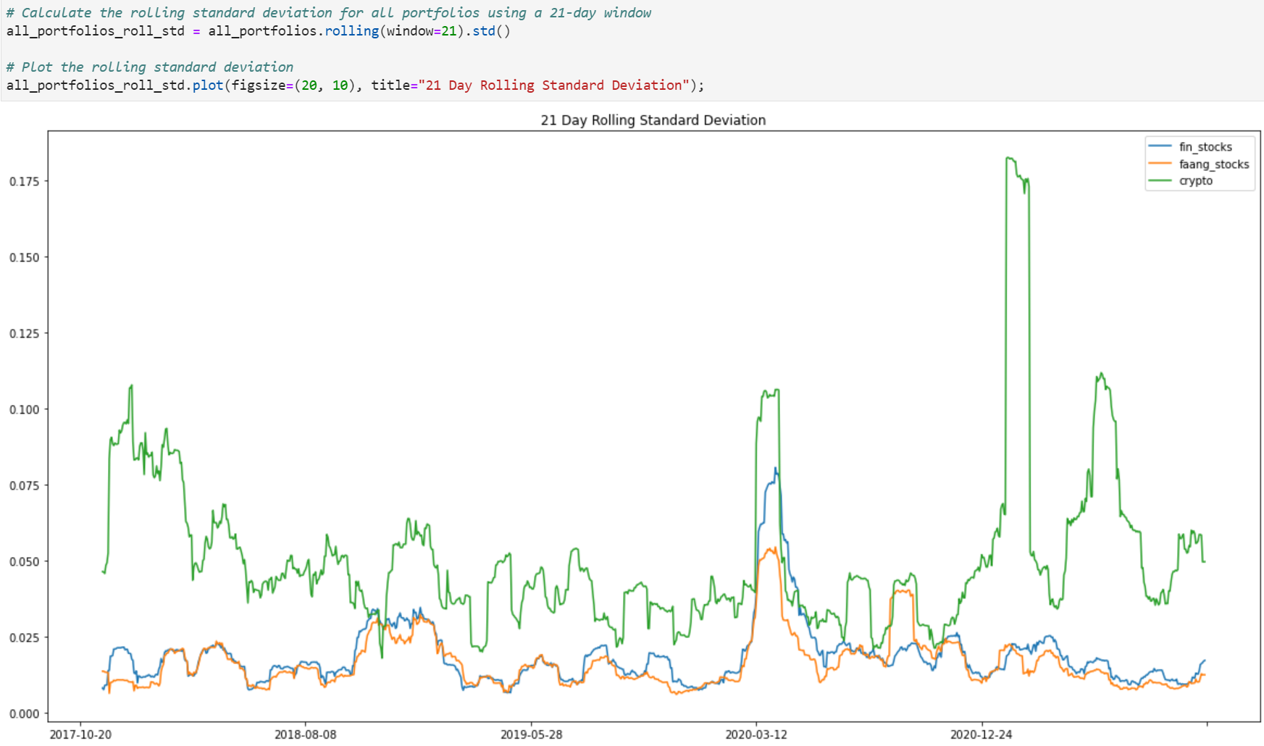
Questions & Data Exploration
What is the best portfolio to allocate
funds to in terms of risk/reward?

Slide 9
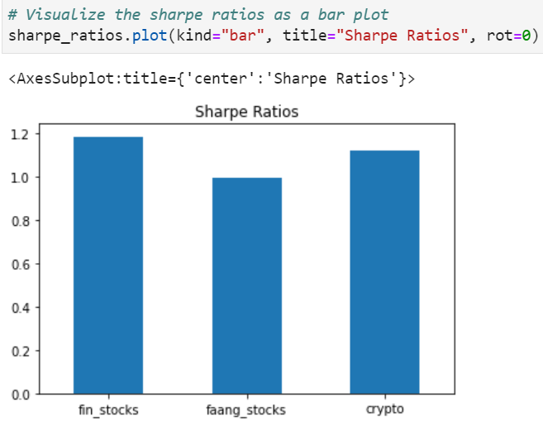
Questions & Data Exploration
What is the best portfolio to allocate
funds to in terms of risk/reward?

Slide 10
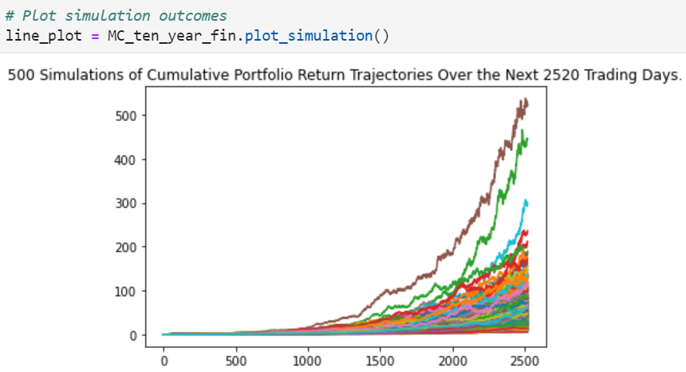
Questions &
Data Exploration
Financial
Portfolio
How could investing in a financial stock portfolio vs. a technology stock portfolio impact retirement planning over 10 years?

Slide 11
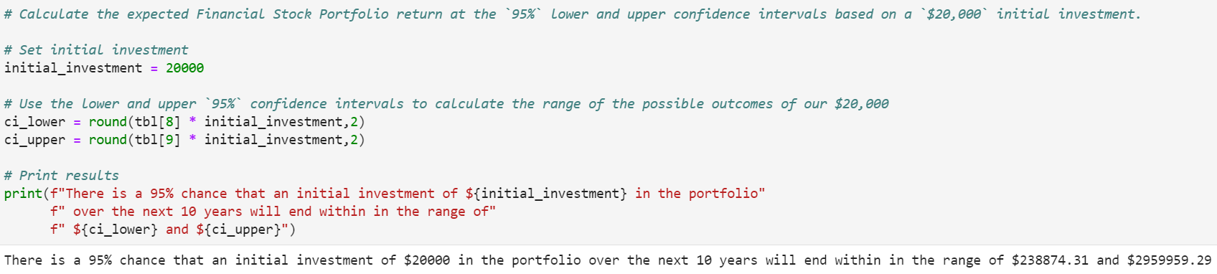
Questions &
Data Exploration
Financial Portfolio
How could investing in a financial stock portfolio vs. a technology stock portfolio impact retirement planning over 10 years?
$20k → between $238,874 and $2,959,959 in 10 years.

Slide 12
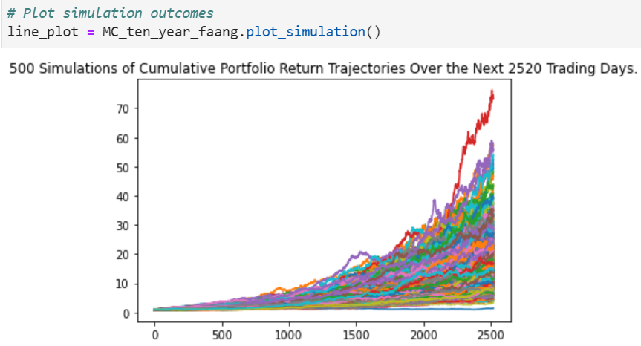
Questions &
Data Exploration
FAANG
Portfolio
How could investing in a financial stock portfolio vs. a technology stock portfolio impact retirement planning over 10 years?

Slide 13
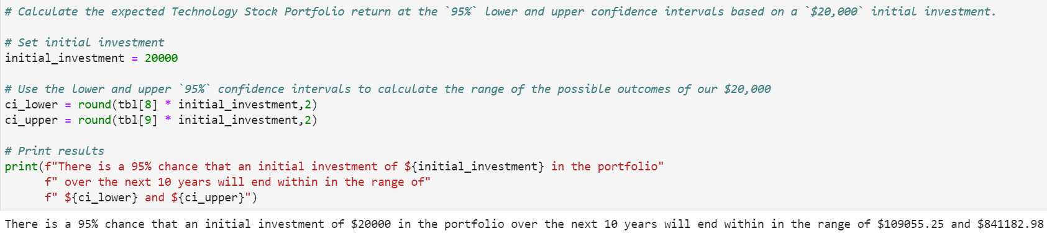
Questions &
Data Exploration
FAANG
Portfolio
How could investing in a financial stock portfolio vs. a technology stock portfolio impact retirement planning over 10 years?
$20k → between $109,055 and $841,182 in 10 years.

Slide 14
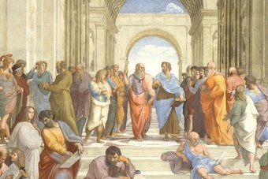
Postmortem
We had issues with the Monte Carlo Simulation for the crypto data. The crypto data pulled in from Santiment did not align with the pre-built simulation code.
We did not successfully create a dashboard of the visualizations in the analysis. We attempted to initiate the code to do so, but ran into issues and ultimately ran out of time.
One of our team members was dropped from the project, causing a heavier lift for the remaining members.
Notes:
Discuss any difficulties that arose, and how you dealt with them.
Discuss any additional questions that came up, but which you didn't have time to answer: What would you research next, if you had two more weeks?

Slide 15
Questions?

